Slide 1
Week 5
Introduction to USING MYSQL

Slide 2
Student Objectives
Upon completion of this video, you should be able to:
Get into and out of MySQL on a Linux machine.
Use 4 basic MySQL commands: show, drop, create and use
Create and drop a database using MySQL
Create and drop a table using MySQL
List at least 4 MySQL datatypes for attributes.
Add MySQL commands to a text file and then pipe those files into MySQL on Linux.
Collect the output from MySQL into a text file.
Using help in MySQL

Slide 3
Running MySQL ON YOUR VIRTUAL MACHINE - Starting it and creating a database
MySQL commands:
From Virtual Machine to get into mysql:
mysql –u root –ppassword
Commands once you are in:
SHOW DATABASES;
drop database if exists vetdb;
create database vetdb;
USE vetdb;
SHOW TABLES;
DROP TABLE tablename;
NOTES – MySQL commands:
SHOW lists all databases
DROP deletes a database
CREATE creates a database
USE allows you to start using a database
Commands are case insensitive, table names/attribute names are case sensitive!

Slide 4
SQL (Structured Query Language) Overview
SQL comprehensive language that is both a DDL and a DML (it creates the database and allows manipulation of the database)
The statement to create the database initially is CREATE DATABASE whateverdbname
NOTE: You should only have to do once to create the database.
We will walk through an actual example from MySQL to illustrate the basic SQL commands.

Slide 5
Data Types in MySQL
http://www.w3resource.com/mysql/mysql-data-types.php

Slide 6
Basic DDL SQL Commands:
Creating and Deleting Tables:
CREATE TABLE TableName (Attr1 type NOT NULL, Attr2 type, Attr3 type, PRIMARY KEY (Attr1)) ;
Example:
CREATE TABLE owner (firstname VARCHAR(20), lastname VARCHAR(20), ownerid INT NOT NULL, PRIMARY KEY (ownerid));
DROP TABLE TableName;

Slide 7
Piping commands into your virtual machine
Log onto your virtual machine
Create a file of commands in a .txt file
Enter this command: sudo mysql --verbose -pyourpassword < script1.txt > outputscript1.txt 2>&1

Slide 8
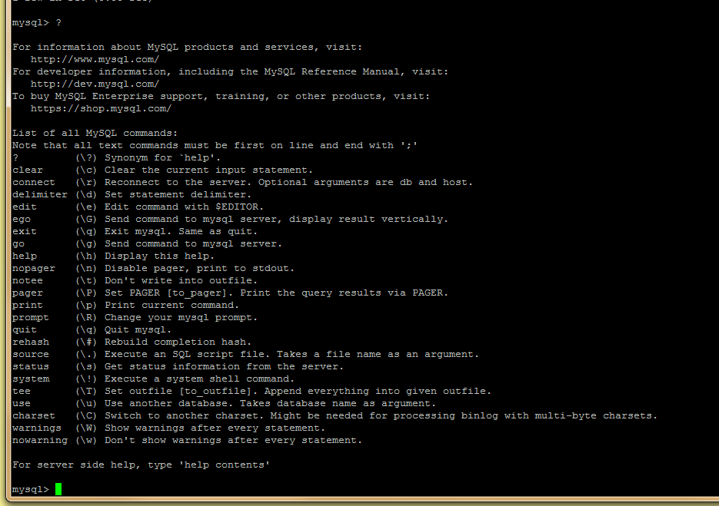
Need Help
Type ?

